Slide 1
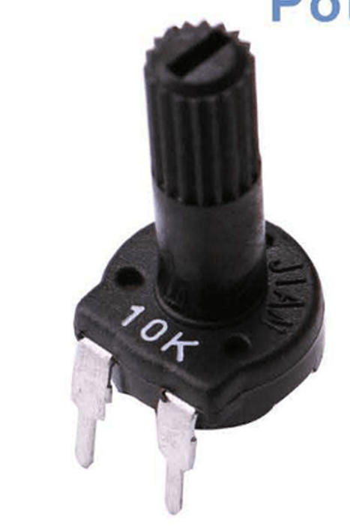
The Potentiometer can vary resistance, allowing you to control brightness of LEDs or provide a rotational signal.
SIGNAL (Goes into Analogue pins (Digital control) or into LED PWR (Analogue control))
5V (+)
GND (+)
These can be interchanged/ It doesn't matter which way round

Slide 2
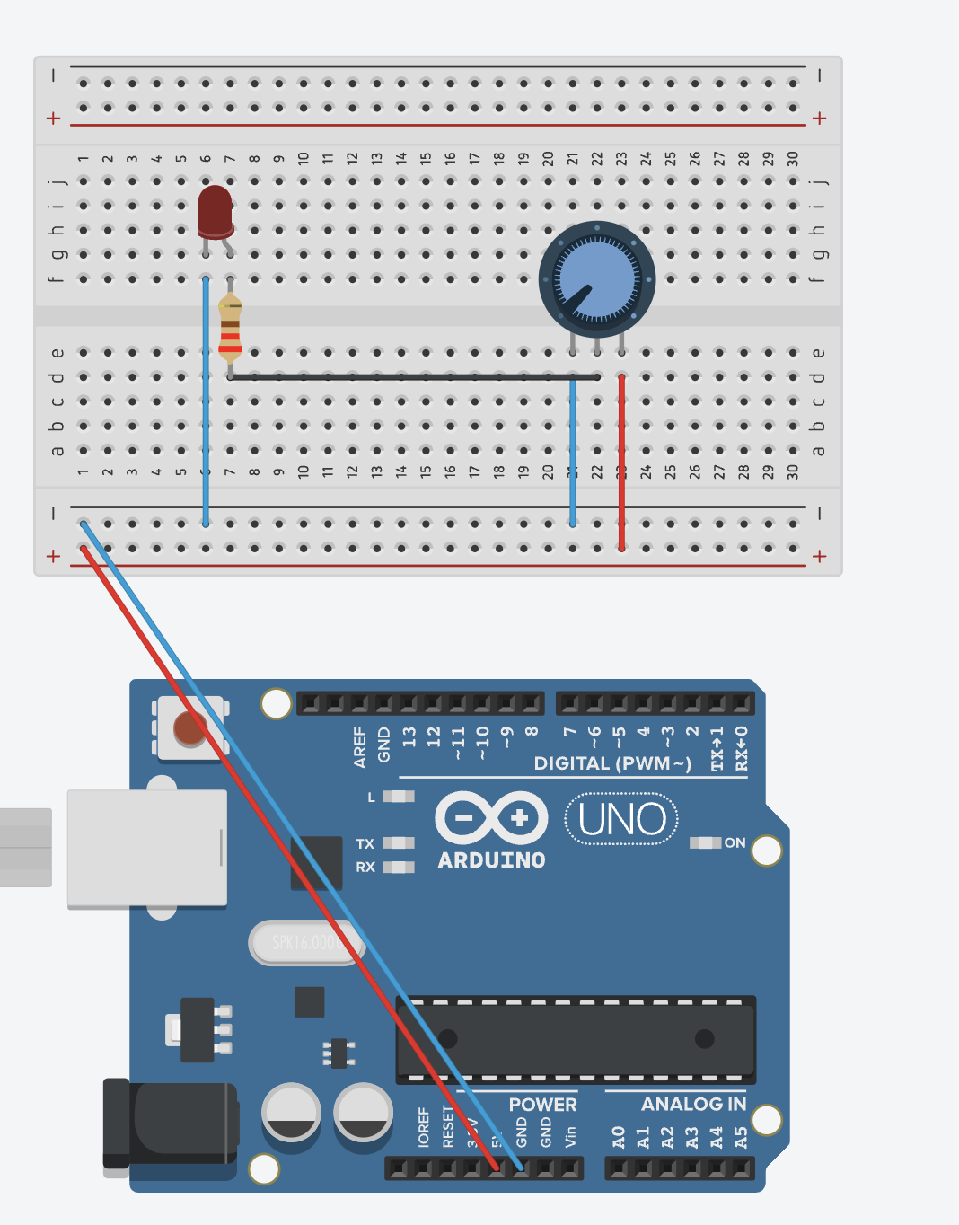
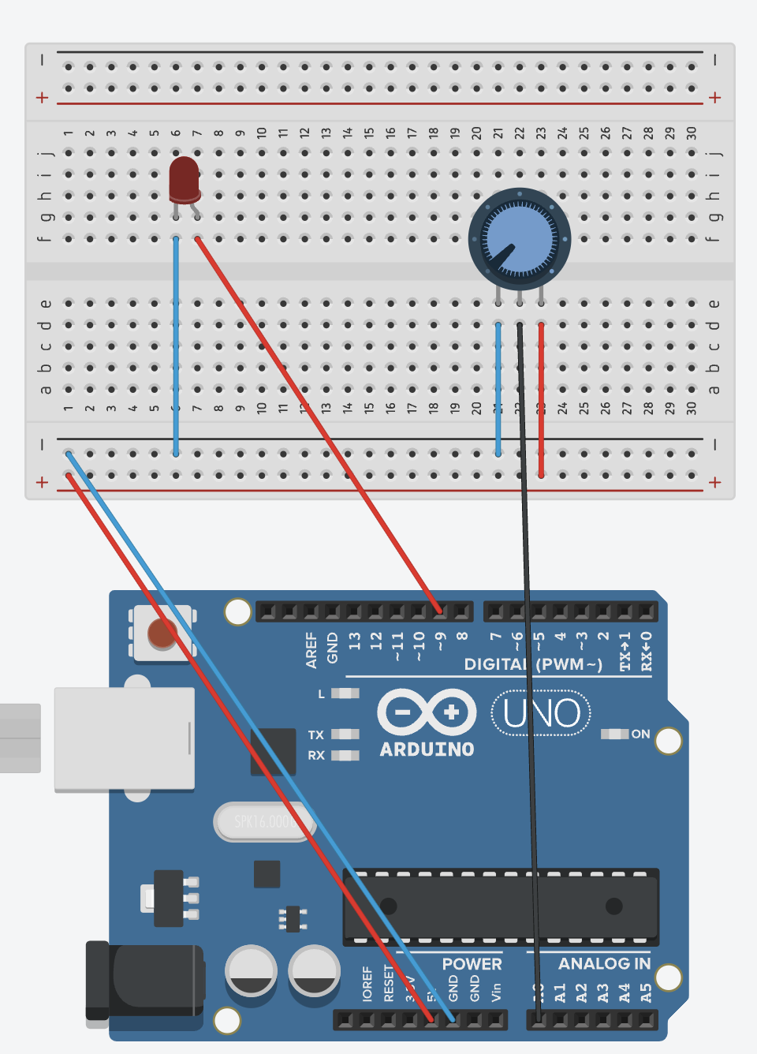
Analogue (No Code)
Digital (Using Code on Slide 3)

Slide 3
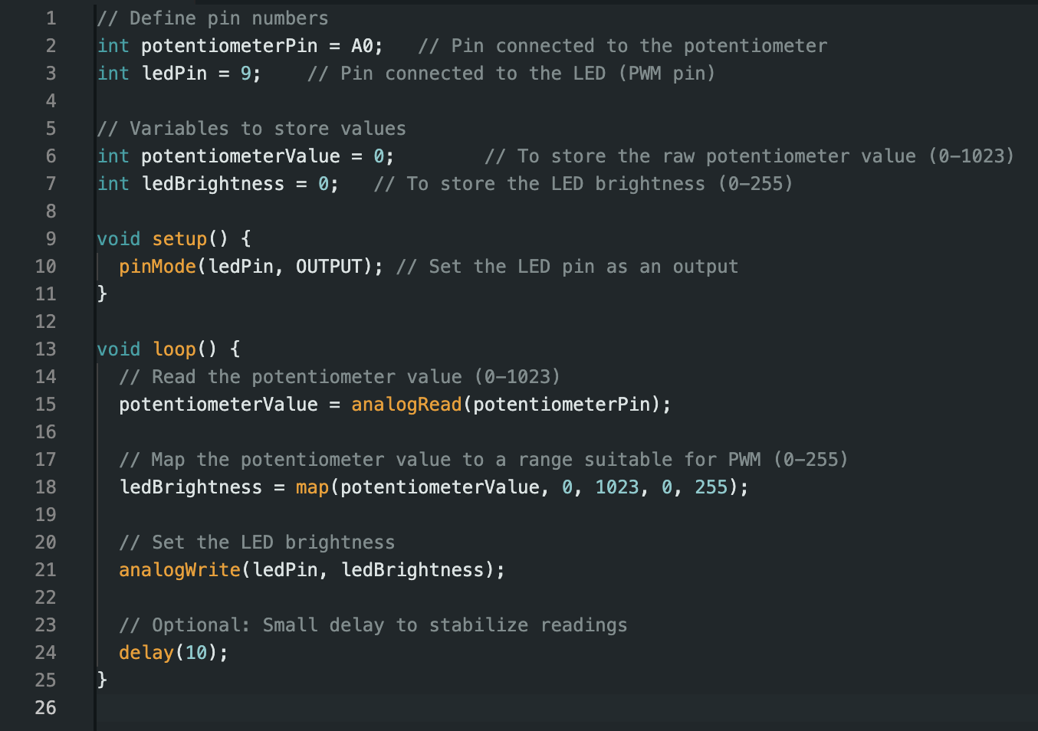
The greyed- out words after a // are comments - you do not need to copy these in your code
Challenge: When you are finished, try using a potentiometer to control multiple LEDs brightness

